Slide 1

Brain Tumor Detection Using Machine Learning

Slide 2
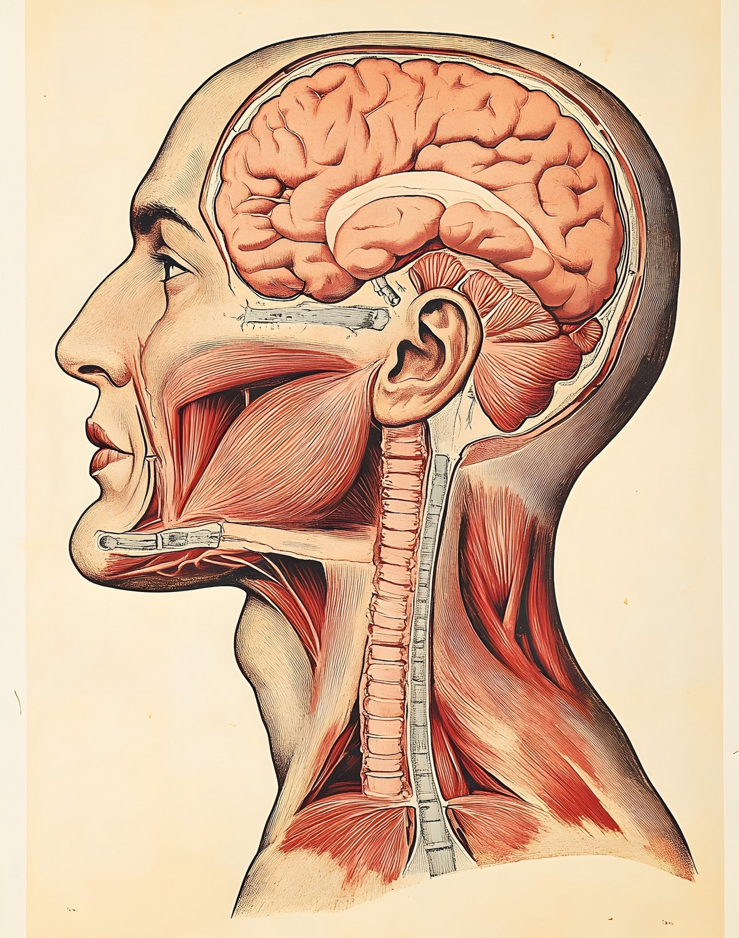
Introduction to Brain Tumors
Brain tumors are abnormal growths of cells in the brain. They can be benign or malignant impacting brain function signiﬁcantly. Early detection is crucial for effective treatment. In this presentation, we will explore how machine Learning algorithms can enhance precision in detecting brain tumors.

Slide 3



Understanding Machine Learning
Machine Learning (ML) is a subset of
that enables systems to learn from data. By
recognizing patterns, ML can make decisions with minimal human intervention. This technology is increasingly being applied in
, including brain tumor
detection.

Slide 4



The Importance of Early
Detection
Early detection of brain tumors can signiﬁcantly improve . Symptoms often vary, making diagnosis challenging. Utilizing
can help in identifying tumors earlier, leading to timely and more effective treatments.

Slide 5
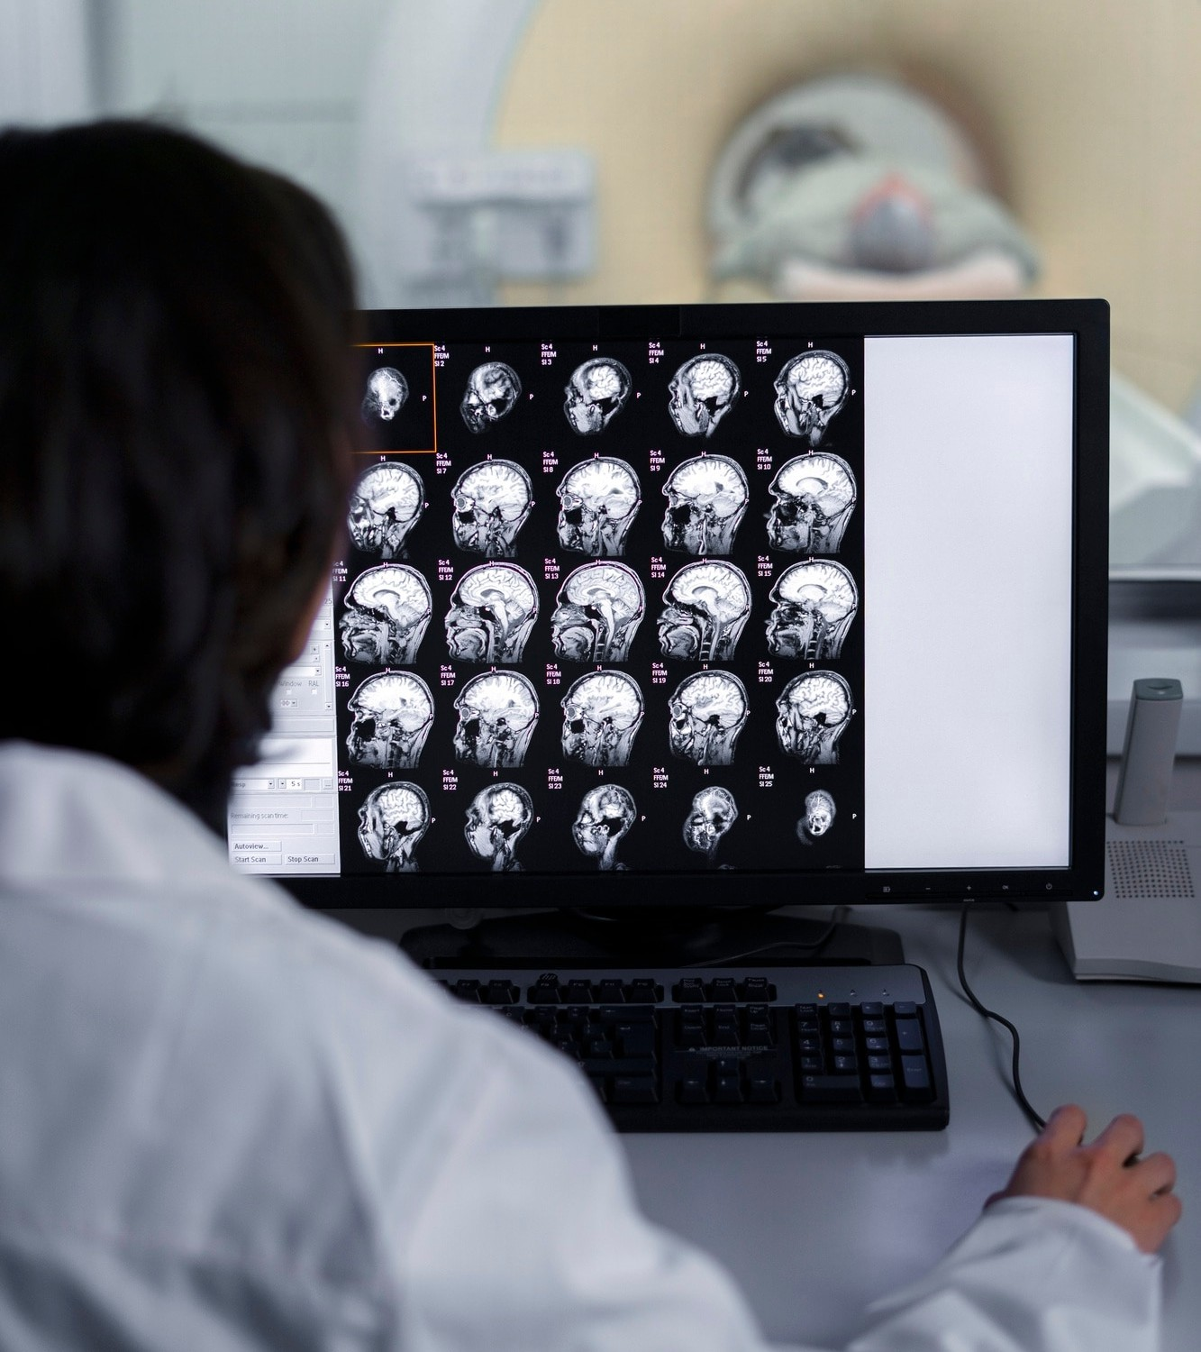


Data Collection Techniques
To train machine learning models,
vast amounts of Techniques such as
are required.
, CT
scans, and patient history are essential for creating comprehensive datasets. Quality data is crucial for improving the accuracy of detection algorithms.

Slide 6





Feature Extraction Methods
Feature extraction involves identifying key from imaging data that can help in tumor detection. Techniques like
and
are used to enhance the model's ability to differentiate between healthy and tumor-
affected tissues.

Slide 7
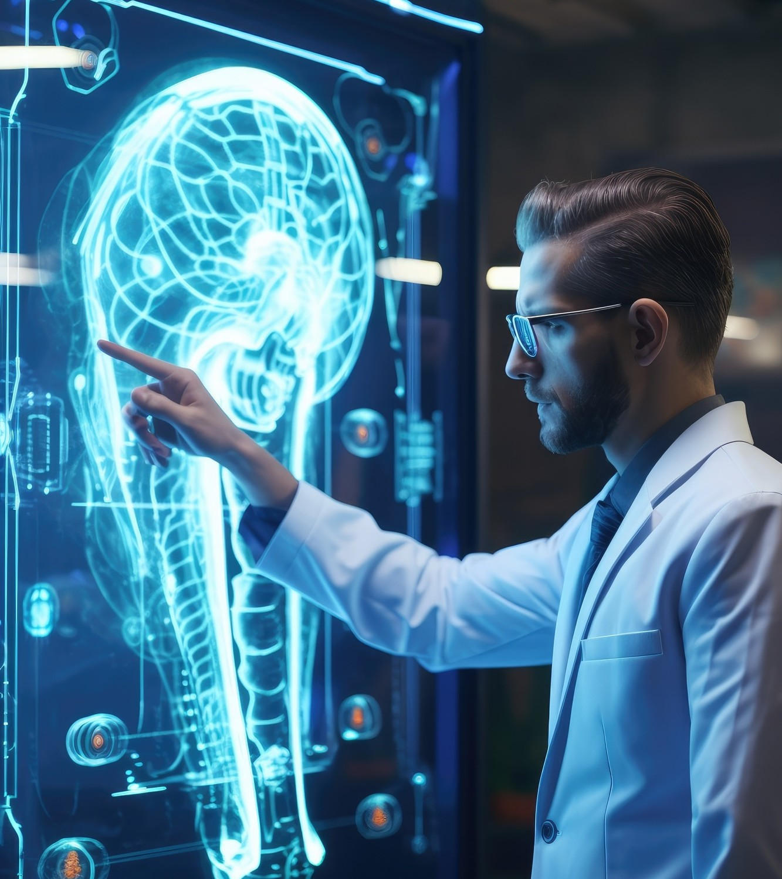

Popular Algorithms in Use
Several
are employed for brain tumor detection, including
, Support Vector Machines (SVM), and Random Forests. Each algorithm has unique strengths that can be leveraged based on the data and desired outcomes.

Slide 8


Training the Model
Training a machine learning model involves feeding it a
to learn from. This process requires careful tuning of parameters and validation to ensure that the model can accurately identify brain tumors in unseen data.

Slide 9




Evaluating Model Performance
Model performance is evaluated
using metrics such as
, and
,
. These
metrics help determine how well the model can detect tumors and minimize false positives, which is critical in clinical settings.

Slide 10
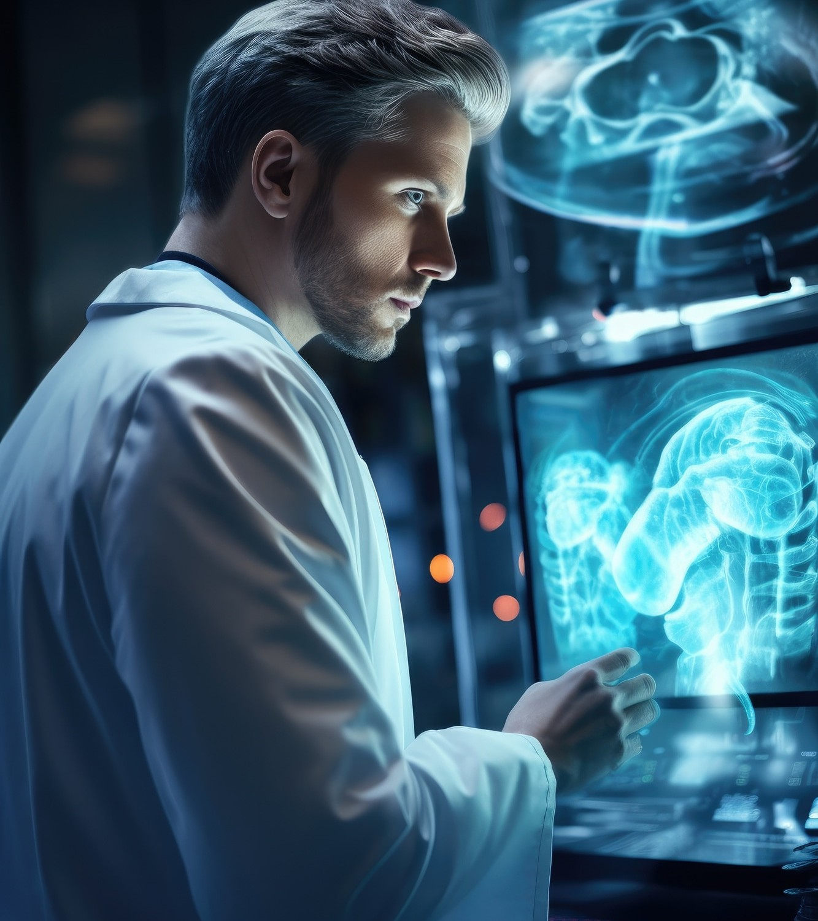


Real-World Applications
Machine learning algorithms are already making strides in
. Hospitals are integrating these technologies to assist radiologists in diagnosing brain tumors, ultimately leading to better patient care and treatment planning.

Slide 11



Challenges and Limitations
Despite advancements, several
persist in machine learning for tumor detection. Issues like , algorithm bias, and the need for extensive labeled datasets can hinder progress.
Addressing these challenges is essential for future developments.

Slide 12





Future Directions
The future of brain tumor detection lies in the integration of
and advanced algorithms. Combining imaging
data with
and
can enhance detection
accuracy and personalize treatment strategies for patients.

Slide 13

Conclusion
Harnessing for brain tumor detection represents a signiﬁcant advancement in medical technology. By improving early detection and treatment precision, we can enhance patient outcomes and revolutionize the ﬁeld of neurology. The journey is ongoing, with promising developments ahead.

Slide 14
Thanks!
Do you have any questions?

